Slide 1
Mathematics (9-1) - iGCSE
2018-20
Year 07
The amount that a plumber charges customers depends on a variety of things, including labour and parts.
Labour might be based on an hourly charge of £60, and a fixed call-out charge of £80. A formula for the total labour charge EC for a job that takes t hours might be C = 60t + 80
How much does the plumber charge for a job that takes 2 hours? How long is the job when the cost is £260?
Unit 2 – Algebra

Slide 2
Contents
Page iv
2 Algebra 30
Prior knowledge check 30
2.1 Algebraic indices 31
2.2 Expanding and Factorising 33
3.3 Equations 35
2.4 Formulae 37
2.5 Linear sequences 40
2.6 Non-linear sequences 42
2.7 More expanding and Factorising 46
Problem-solving 48
Checkup 50
Strengthen 51
Extend 55
Knowledge check 58
Unit Test 59

Slide 3
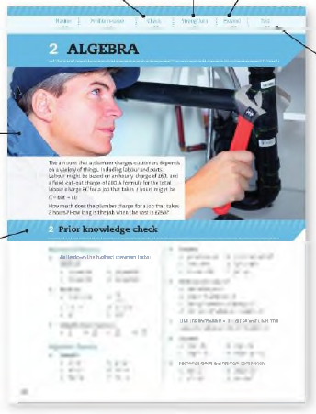
Contents
Page v
At the end of the Master lessons, take a check-up test to help you to decide whether to strengthen or Extend our learning
Extend helps you to apply the maths you know to some different situations
Unit Openers put the maths you are about to learn into a real-life context. Have a go at the question - it uses maths you have already learnt so you should be able to answer it at the start of the unit.
When you have finished the whole unit, a Unit test helps you see how much progress you are making.
Choose only the topics in strengthen thay you need a bit more practice with. You’ll find more hints here to lead you through specific questions. Then move on to Extend
Use the Prior knowledge check to make sure you are ready to start the main lessons in the unit. It checks your knowledge from Key Stage 3 and from earlier in the GCSE course. Your teacher has access to worksheets if you need to recap anything.

Slide 4
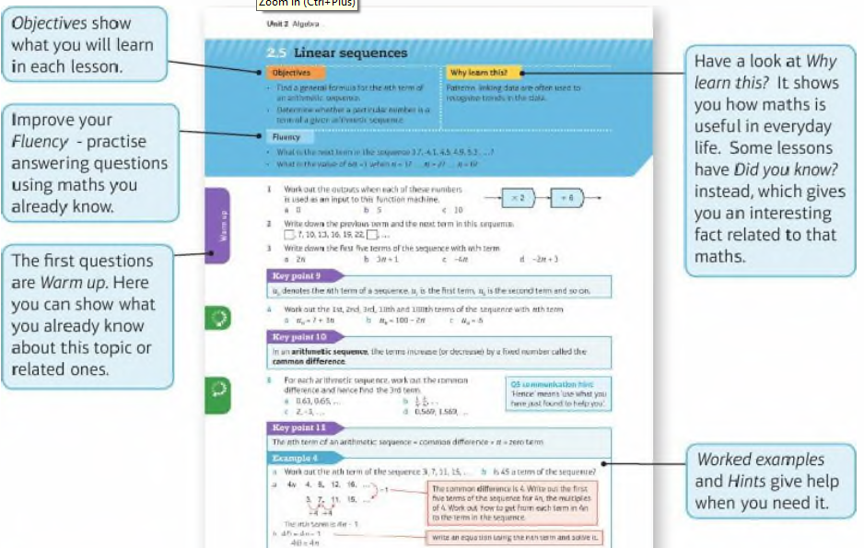
Contents
Page vi

Slide 5
Contents
Page vi

Slide 6
2 – Prior Knowledge Check
Page 30
Numerical fluency
Write down the highest common factor (HCF) of
12 and 18 b. 15 and 35
30 and 36 d. 22 and 44
Work out
(-3) x (-4) b. $\frac{6}{−3}$
-4 - 7 d. 5 - (-3)
2⁴ f. (3²)²
Simplify these fractions. a. $\frac{2}{4}$ b. $\frac{10}{25}$ c. $\frac{18}{24}$ d. $\frac{30}{3}$

Slide 7
2 – Prior Knowledge Check
Page 30
Algebraic fluency
Simplify
x + x b. y x y
w x 2 d. 4l ÷ 4
5q ÷ q f. 3z – z
Simplify
p x p x p x p b. c x c x d x d x d
7m x 2m d. 3f x (-6f)
x x 4x x 9x f. y² ÷ y
Work out the value of
4p² when p = 2
2(m + 7) when m = 3
5x + y² when x = 2 and x = 3
10 - (s + 1)² when s = 1 and t = 2

Slide 8
2 – Prior Knowledge Check
Page 30
Algebraic fluency
Use the formula v = u + at to work out the value of v when u = 10, a = 2 and t = 3.
Expand
7(x + 3) b. 2(x - 3)
3(y² + 7) d. 9(2x - y + 1)
Factorise each expression completely,
8x - 2 b. 20y + 15
c² - 2c d. n + 2n²
Solve these equations. Show your working.
x + 7 = 5 b. 5x - 1 = 19
5(x - 3) = 10 d. 4(x + 1) = 36

Slide 9
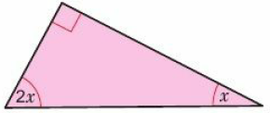
2 – Prior Knowledge Check
Page 31
Algebraic fluency
Find the value of x in the formula R = 2ax - b when R = 23, a = 3 and b = 7.
Write an equation and use it to find the value of x in the diagram.
Make x the subject of each.
x - 5 =y b. 4x = y

Slide 10
2 – Prior Knowledge Check
Page 31
Algebraic fluency
a. Work out the output of this function machine when the input is 4.
By using an Inverse function machine, or otherwise, find the input when the output is 48.
Use these position-to-term rules to work out the first four terms of each sequence,
7n + 2 b. 20 - 6n
Write down the term-to-term rule and the next two terms of each sequence.
2, 11, 20, .... b,. -1, -3, -9, ...
6, 2, -2, ... d. 2, 0.2, 0.02, ...
Add 7
Double
4

Slide 11
2 – Prior Knowledge Check
Page 31
a. Which of the sequences in Q16 are a arithmetic
geometric c ascending d descending?
Write down the first four terms of the sequence defined by
first term = 4 term-to-term rule is 'add 7'
first term = 3 term-to-rule is 'multiply by 2'

Slide 12
2 – Prior Knowledge Check
Page 31
* Challenge
a. Work out
1 + 2
1 + 2 + 3
1 +2 + 3 + 4
1 + 2 + 3 + 4 + 5
By substituting n = 2,3,4 and 5 into the formula $\frac{1}{2}$(n + 1), verify that this formula produces the sum of the first n positive whole numbers,
Use the formula in part b to work out the sum of the first 100 whole numbers,
Work out
13 + 23
13 + 23 + 33
13 + 23 + 33 + 43
13 + 23 + 33 + 43 + 53
By comparing your answers with those for part a, write down a formula for the sum of the first n cube numbers.

Slide 13
2.1 – Algebraic Indices
Page 31
Objectives |  | Why Learn This
Use the rules of indices to simplify algebraic expressions |  | Algebraic functions have the same rules that you used with numbers in unit 1
Fluency
Evaluate $\sqrt{16}$ x $\sqrt{16}$ $\sqrt{25}$ x $\sqrt{25}$ $\sqrt[3]{8}$ x $\sqrt[3]{8}$ $\sqrt[3]{8}$x $\sqrt[3]{8}$ x $\sqrt[3]{8}$

Slide 14
2.1 – Algebraic Indices
Page 31
Write as a power of 2.
2³ x 2⁴ b. 2⁵ ÷ 2²
(2³)⁴ d. $\frac{1}{2}$
Write as a power of a single number.
$\frac{104 x 103}{102}$
(5⁻²)³ x 5⁹
$\frac{\left(310\right)1/2}{32}$
Warm Up
ActiveLearn - Homework, practice and support: Higher 2.1

Slide 15
2.1 – Algebraic Indices
Page 32
Simplify
x³ x x⁴ b. x² x x⁵
a⁷ x a⁴ d. y² x y³ x y⁴
m^{½} x m^{3/2}
Simplify
2a³ x 3a⁵ b. 4c x 2c⁵
4n² x 10n⁵ d. v³ x 7v²
5s²t x 3s³t⁵
2pq² x 5p²q³ x 3p³q

Slide 16
2.1 – Algebraic Indices
Page 32
Simplify
x⁵ ÷ x³ b. x⁷ ÷ x⁴
$\frac{p8}{p5}$ d. y⁷ ÷ y
$\frac{r10}{r9}$ f. $\frac{t3 x t5}{t6}$
Simplify
$\frac{14g10}{7g8}$ b. $\frac{6f5}{2f}$
6x⁴ ÷ 2x²

Slide 17
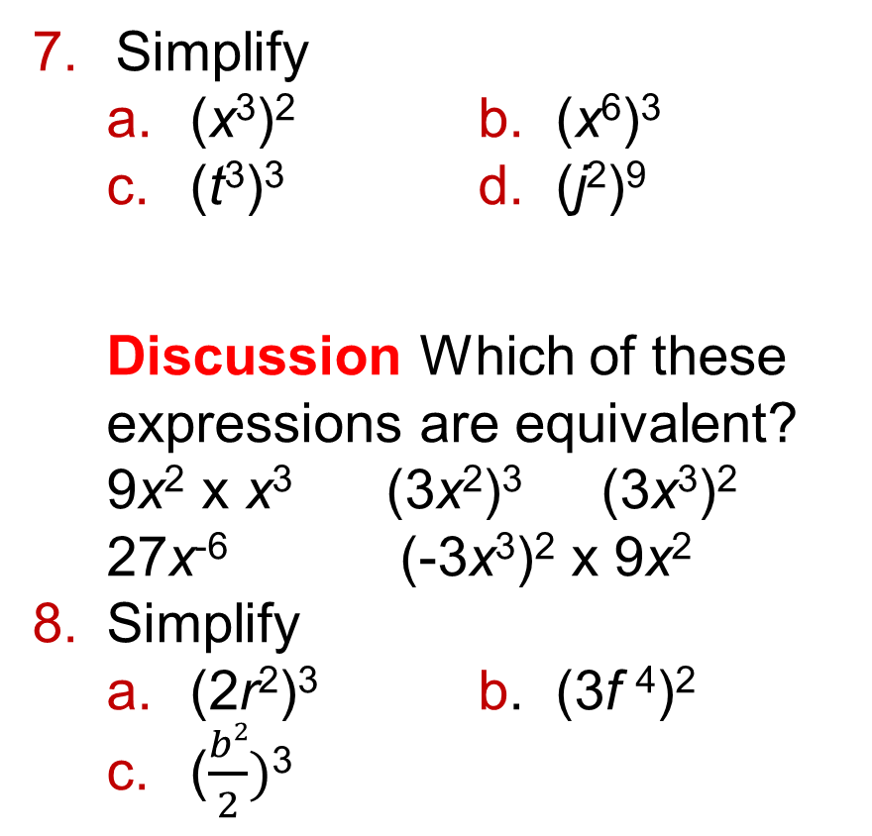
2.1 – Algebraic Indices
Page 32
Simplify
(x³)² b. (x⁶)³
(t³)³ d. (j²)⁹
Discussion Which of these expressions are equivalent? 9x² x x³ (3x²)³ (3x³)² 27x⁻⁶ (-3x³)² x 9x²
Simplify
(2r²)³ b. (3f ⁴)²
($\frac{b2}{2})$³

Slide 18
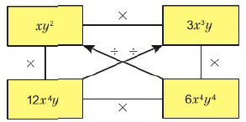
2.1 – Algebraic Indices
Page 32
Multiply or divide each pair of expressions connected by a line in this diagram. Divide in the direction of the arrow. Reflect Which pair of expressions was easiest to multiply/divide? Why? Which pair was hardest? Why?
Simplify
(2x²y³)³ b. (6x⁵y²)²
(3x2y)⁴ d. ($\frac{2x4y5}{3xy3}$)²

Slide 19
2.1 – Algebraic Indices
Page 32
Reasoning Copy and complete
x³ ÷ x³ = x^{◻ - ◻} = x◻ x³ ÷ x³ = $\frac{\text{x}\text{3}}{\text{x}\text{3}}$ = ◻ Therefor x◻ =◻
x³ ÷ x⁴ = x^{◻ - ◻} = x◻ x³ ÷ x⁴ = $\frac{\text{x} x \text{x} x \text{x}}{\text{x} x \text{x} x \text{x}x \text{x}}$ = $\frac{\text{◻}}{\text{◻}}$ Therefor x◻ =$\frac{\text{◻}}{\text{◻}}$
x³ ÷ x⁵ = x^{◻ - ◻} = x◻ x³ ÷ x⁵ = $\frac{\text{x} x \text{x} x \text{x}}{\text{x} x \text{x} x \text{x}x \text{x}x \text{x}}$ = $\frac{\text{◻}}{\text{◻}}$ Therefor x◻ =$\frac{\text{◻}}{\text{◻}}$
Q11b hint – x has a negative power

Slide 20
2.1 – Algebraic Indices
Page 33
Key Point 1
xº = 1 and x^{-m} = $\frac{\text{1}}{\text{x}\text{m}}$
Simplify
b¹ b. h⁻³
p⁰ d. r⁻⁶
Q12b hint – h⁻³ = (h³)⁻¹ = $\frac{\text{1}}{\text{◻}\text{◻}}$
13 – Exam-Style Questions
Simplify 3c²d³ x 4cd⁻² (3 marks)
x⁻⁴ x x^{n} = x⁷ Work out n. (1 mark)
Exam Hint
In part a first multiply the numbers then simplify c² x c and d³ x d⁻².

Slide 21
2.1 – Algebraic Indices
Page 33
Simplify
(t⁻²)⁻³ b. (x⁻¹)⁻²
(q²)⁰ d. (w⁻¹)⁻¹
Simplify
(x⁷y²)⁰ b. (e²f³)⁻¹
(2p⁵q)⁻² d. $\frac{(2u4)−1}{5v3}$
Simplify
$\sqrt{x4}$ b. $\sqrt{9x2}$
$\sqrt{4x8}$ d. $\sqrt{16x4y6}$
Q14b hint – negative x negative = positive
Q16a hint – x ◻ x x◻ = x⁴

Slide 22
2.1 – Algebraic Indices
Page 33
Key Point 2
x^{1/n} = $\sqrt[n]{x}$
Simplify
(3pq⁻⁴)⁻²
(16c⁶)^{½}
(4x⁻²y⁸)^{-½}
(32x¹⁰y⁻⁵)^{-1/5}
Q18 hint – Begin by writing (3pq⁻⁴)⁻² = 3⁻²p⁻²(q⁻⁴)⁻²

Slide 23
2.2 – Expanding and Factorising
Page 33
Objectives |  | Why Learn This
Expand brackets. Factorise algebraic expressions. |  | Writing expressions in more than one way helps you to work with them in the easiest way
Fluency
Simplify $y x y$ 4x x x -2p x p x x y s x r
ActiveLearn - Homework, practice and support: Higher 2.2

Slide 24
2.2 – Expanding and Factorising
Page 33
Expand
4(x + 2) b. 3(q - 5)
7(2m + 1) d. -2(p + 6)
Simplify by collecting like terms.
4a + 2 + 5a + 3
3x + 5 - 2x – 1
4r + 2s - 4r + 3s
Find the highest common factor (HCF) of
12 and 10 b. 18 and 27
9x and 15
Warm Up

Slide 25
2.2 – Expanding and Factorising
Page 34
Reasoning a. Write down an expression containing brackets for the area of the rectangle.
Copy and complete this diagram to show the areas of the two small rectangles.
What do you notice about your answers to parts a and b?
Key Point 3
When the two sides of a relation such as 2(x + 5) = 2x + 10 are equal for all values of x it is called an identity and we write 2(x + 5) = 2x +10 using the '≡' symbol.
An equation, such as 2x = 6, is only true for certain values of* (in this case * = 3).

Slide 26
2.2 – Expanding and Factorising
Page 34
Reasoning State whether each relation is an equation or an identity. Rewrite the identities using ≡.
x x x = x²
3x + 4x - x = 6x
3x - 1 = 2x + 1 d. $\frac{6x}{3}$ = 2x
Reasoning By drawing rectangles show that
3x(x + 4) ≡ 3x² + 12x
x(2y + z) ≡ 2xy + xz
x(y + z) ≡ xy + xz
Key Point 4
To expand a bracket, multiply each term inside the brackets by the term outside the brackets.

Slide 27
2.2 – Expanding and Factorising
Page 34
a. Expand
5x(y + 4) ii. 3y(x + 2)
Use your answers to part a to expand and simplify 5x(y + 4) + 3y(x + 2)
Expand and simplify
6(e + 3) + 2e b. 6y + 2(y + 7)
3(x + 9) + x
6(m + 2) +3(m) +5)
2a + 5b + 3(a + b)
2(5x + y) + 3(x + 2y)
Q7b hint - Add the two expansions in part a and collect like terms.
Q8 hint - Expand all brackets first. Then collect like terms.

Slide 28
2.2 – Expanding and Factorising
Page 34
Expand and simplify
x(x - 2) b. 4(y - 3) + 7y
7t + 3(t - 2)
2p(p + q) - q(p - q)
2w - w(1 – 3w)
5e(e +f) – 2f(e - f)
Find the HCF of
4x and 6xy
3xy and 5x
8xy and 12y
5x²y and 10xy²
Q10 hint - What is the HCF of the numbers? Which letters are common factors?

Slide 29
2.2 – Expanding and Factorising
Page 34
Factorise completely
2x+ 12
4x + 6xy = ◻(◻ + ◻)
3ab - 5b d. 7xy + 7xz
ab - abc f. t³ + 2t²
6p²q - 9pq
3x²z + 12xz
20jk² – 15j²k
12pqr - 10pqs
Q11 hint - Write the HCF outside the brackets. Use your answer to Q10a.
Q11 strategy hint - Expand brackets to check.

Slide 30
2.2 – Expanding and Factorising
Page 35
a. What is the HCF of 4(s + 2t)² and 8(s + 2t)?
Copy and complete 4(s + 2t)² - 8(s + 2t) = ◻(s + 2t)[(s + 2t) - ◻] = ◻(s + 2t)(s + 2t - ◻)
Factorise completely
14(p + 1)² + 21(p + 1)
5(c +1)² - 10(c + 1)
12(y + 4)² - 8(y + 4)
(a + 36)² - 2(a + 3b)
5(f + 5) + 10f(f + 5)
5(a + b)² - 10(a + b)
Q12b hint - Use your answer to part a.
Q12 communication hint - Consecutive integers are one after the other.

Slide 31
2.2 – Expanding and Factorising
Page 35
Example
Show algebraically that the product of any two consecutive integers is divisible by 2.
One of these two numbers must be even, so it can be written as 2m for some whole number, m.
If the other number is n then their product is 2m x n= 2mn. 2mn has a factor of 2 so it is divisible by 2.
Numbers 1, 2, 3, 4, 5 are odd, even, odd, even, odd, etc. so a pair of consecutive numbers must contain one odd and one even. If a number is even it is in the 2 times table.
Communication / Reasoning Show algebraically that the product of three consecutive integers is divisible by 6. Discussion What happens for four consecutive integers? Can you use algebra to show it?
Q14 hint - When the numbers are consecutive at least one of them is even and one of them is a multiple of 3.

Slide 32
2.2 – Expanding and Factorising
Page 35
15 – Exam-Style Questions
Expand 4x(2x - 5y) (1 mark)
Factorise completely 4cp - 6cp² (1 mark)
Simplify $\sqrt{\text{(9}\text{m}\text{4}\text{n}\text{6}\text{)}}$ (2 marks)
Exam hint
Make sure that your final answer cannot be factorised further.
Reflect In this lesson you have learned about expanding, simplifying and factorising. Why do you think these methods have these names?

Slide 33
2.3 – Equations
Page 33
Objectives |  | Why Learn This
Solve equations involving brackets and numerical fractions Use equations to solve problems. |  | You can use an equation to work out the distances travelled of a car journey.
Fluency
I think of a number, double it, add 1, The answer is nine. What number did I think of?
ActiveLearn - Homework, practice and support: Higher 2.3

Slide 34
2.3 – Equations
Page 36
Warm Up
Solve these equations.
4i-5=23
3(7*+ 4) = 33
9 = 3(7-2*)
Write down the lowest common multiple (LCM) of
2 and 3
6 and 8
2, 3 and 12
Show that x = 3 is a solution of the equation x³ - 2x = 21
Expand and simplify
2(4x + 3)
2(3x + 1) + 3(5x - 2)
2(2x +1) - 3(4x - 5)

Slide 35
2.3 – Equations
Page 36
a. Copy and complete to begin to solve the equation.
3x + 1 = 5x - 9 3x +1 - ◻ = 5x – 9 - ◻
◻ = ◻x - 9
Solve the equation.
Solve
2x + 4 = x + 9
5x + 3 = 7x – 5
x - 5 = 3x -25
11x - 7 = 9x - 11
Q5a hint - Subtract 3x from both sides of the equation. Then simplify the expression on both sides of the equation

Slide 36
2.3 – Equations
Page 36
a. Expand
4(3x - 4) ii. 7(x - 3)
Use your answers to part a to solve 4(3x - 4) = 7(x - 3)
a. Expand and simplify 2(3x + 5) - 3(x - 2)
Use your answer to part a to solve 2(3x + 5) - 3(x - 2) = 25
Solve these equations.
2(3x - 1) + 5(x + 3) = 24
2(x - 1) - (3x - 4) = 3
Key Point 5
Unless a question asks for a decimal answer, give non-integer solutions to an equation as exact fractions.

Slide 37
2.3 – Equations
Page 36
Solve
2(4x - 1) + 3(x + 2) = 1
4(2x + 3) = 5(3x - 2)
3(2x + 9) = 2(4x - 1)
9x - 2(3x - 5) = 6
5(4x - 3) - (6 - 5x) = 0
7(3 - 5x) = 2(x - 6)
Discussion In part a, why is the fraction solution more accurate than the decimal?
Simplify these expressions by cancelling.
$\frac{14\text{x}}{7}$ b. $\frac{4\text{y}}{8}$ c. $\frac{27\text{z}}{3}$ d. $\frac{\text{24}\text{w}}{4}$
Q3 hint - $\frac{14}{7}$ x x = ◻x.

Slide 38
2.3 – Equations
Page 36
a. Copy and complete to begin to solve the equation. $\frac{7\text{x}\text{ −} 1}{4}$ = 5 $\frac{7\text{x}\text{ −} 1}{4}$ x ◻ = 5 x ◻ 7$\text{x}$ -1 = ◻
Solve the equation.
Copy to begin to solve the equation. $\frac{10}{\text{x} −4}$ = 3 $\frac{10}{\text{x} −4}$ x (◻) = 3 x (◻) 10 = ◻$\text{x}$ - ◻
Solve the equation.
Q12a hint Multiply both sides of the equation by 4. Then cancel.
Q13a hint Multiply both sides by x - 4. Then cancel the left-hand side and expand the right-hand side

Slide 39
2.3 – Equations
Page 37
a. By multiplying both sides of the equation $\frac{2x + 1}{3}$ = $\frac{x − 5}{9}$ by 9, and cancelling, show that 3(2x +1) = x - 5. Then solve the equation,
By multiplying both sides of the equation $\frac{x}{2}$ - $\frac{x}{3}$ = $\frac{7}{12}$ by 12, and cancelling, show that 6x - 4x = 7. Then solve the equation.
Discussion How can you choose the number to multiply by?
Q14b hint - $\frac{x}{2}$ x 12 = $\frac{12x}{2}$ = ◻x
-$\frac{x}{3}$ x 12 = $\frac{−12x}{3}$ = ◻x

Slide 40
2.3 – Equations
Page 37
Key Point 6
To solve an equation involving fractions, multiply each term on both sides by the LCM of the denominators.
Solve these equations.
$\frac{b − 4}{2}$ = $\frac{b+1}{4}$ b. $\frac{n}{2}$ - $\frac{12x}{5}$ = $\frac{3}{10}$
$\frac{c −1}{4}$ + $\frac{c+1}{8}$ = $\frac{3}{2}$ d. $\frac{2}{3x+1}$ = 5
$\frac{x −1}{3}$ + $\frac{x + 1}{2}$ + $\frac{x}{6}$ = 7
Q14b hint - Begin by multiplying both sides by the LCM of 2 and 4.

Slide 41
2.3 – Equations
Page 37
Problem-solving Find the size of the smallest angle in the triangle.
Q16 strategy hint - What fact do you know about angles in a triangle?

Slide 42
2.3 – Equations
Page 37
Real / Reasoning Bert drove from his house to Bolton at an average speed of 60mph. He drove back at an average speed of 45mph. His total driving time was 7 hours,
Bert lives x miles from Bolton. Write down an expression for the time of his outward journey,
Write down an expression for the time of his return journey,
Write down an equation for both parts of the journey in terms of x.
Solve the equation to work out how far Bert lives from Bolton.
Q17 hint – Time = $\frac{Distance}{Speed}$

Slide 43
2.4 – Formulae
Page 37
Objectives |  | Why Learn This
Substitute numbers into formulae. Rearrange formulae. Distinguish between expressions, equations, formulae and identities. |  | You can use a formula to workout the acceleration of a Formula 1 racing car.
Fluency
Use the formula A = lw to calculate the area of a rectangle of length 3m and width 2m.
ActiveLearn - Homework, practice and support: Higher 2.4

Slide 44
2.4 – Formulae
Page 37
Workout
6 - (3 -1)
25 – 3 x 4
2 x 4²
2 x 4 – 3 x 5 + 4 x 6
a. Write 75 million in standard form.
Write 3 x 10⁸ as an ordinary number.
Use a calculator to work out 1.05⁴. Round your answer to 2 decimal places.
Warm Up

Slide 45
2.4 – Formulae
Page 38
Key Point 7
An expression contains letter and/or number terms but no equal signs, e.g. 2ab, 2ab + 3a²b. 2ab - 7
An equation has an equals sign, letter terms and numbers. You can solve it to find the value of the letter, e.g. 2x - 4 = 9x + 1
An identity is true for all values of the letters, e.g. $\frac{4x}{2}$ ≡ 2x, x(x + y) = x² + xy
A formula has an equals sign and letters to represent different quantities, e.g. A = πr².
The letters are variables as their values can vary.

Slide 46
2.4 – Formulae
Page 38
Write whether each of these is an expression, an equation, an identity or a formula.
E = mc² b. 4x + 7 = 2x
2v d. 2(x + y) = 2x+ 2y
2p²q³ f. C = 2πr
πd h. 2πr = 7
(uv²)⁴ = u⁴v⁸
$\frac{2x}{5}$ = 9
Reflect Write your own examples of an expression, an equation, an identity and a formula. Beside each one, write how you know what it is.

Slide 47
2.4 – Formulae
Page 38
Use the formula Q = 2P³ to work out the value of Q when
P= 10 b. P = -1
Use the formula D = 2X² + Y to work out the value of D when
X = 10 and Y = 150
X = -2 and Y = 0
Real / Reasoning The instructions describe how to cook a joint of beef.
Work out the total time taken to cook a 2.5 kg joint of beef,
Write a formula for the total time, T (minutes) to cook m kg of beef.
Cook for 30 minutes at 220°C, followed by 40 minutes per kilogram at 160°C.

Slide 48
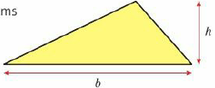
2.4 – Formulae
Page 38
Problem-solving
Write a formula, in terms of b and h, for the area, A, of the triangle.
Use the formula to work out the value of
A when b = 6 and h = 3
b when A = 20 and h = 4

Slide 49
2.4 – Formulae
Page 38
Finance An amount £P is put into a bank account offering r% interest. After n years the value of the savings, S, is given by the formula S = P(1 + $\frac{r}{100}$)^{n} Joe invests £10,000 in this account in January 2015. The interest rate is 4.6%. How much will his investment be worth in January 2020? Give your answer to the nearest penny.

Slide 50
2.4 – Formulae
Page 38
STEM / Problem-solving A car, initially travelling at a speed of u m/s, accelerates at a constant rate of a m/s². The distance, s, travelled in t seconds is given by the formula s = ut + ½at².
A car joins a motorway travelling at 10 m/s and has a constant acceleration of 0.6 m/s². Work out the distance travelled by the car in 20s.
Work out the acceleration of a Formula 1 car which starts from rest and travels 70m in 2.5s.
Q10a strategy hint - Write down the information you are given, u = ◻, a = ◻, t = ◻. Then substitute into the formula.
Q10b hint - At rest, u = 0. Substitute all the information into the formula. Then find a.

Slide 51
2.4 – Formulae
Page 39
Key Point 8
The subject of a formula is the letter on its own, on one side of the equals sign.
Example 2
Make a the subject of the formula v² = u² + 2as
Make x the subject of the formula y = $\frac{ax+b}{c}$
v² = u² + 2as b. y = $\frac{ax+b}{c}$
$\frac{\text{v}\text{2} \text{−} \text{u}\text{2}}{2s}$ = a cy –b = ax
a = $\frac{\text{v}\text{2}\text{ − }\text{u}\text{2}}{2s}$ $\frac{cy − b}{a}$ = x
x = $\frac{cy − b}{a}$
Subtract u² from both sides.
Multiply both sides by c.
Subtract b from both sides
Divide both sides by 2s
Divide both sides by a.
Re-write in the form of a = .
Re-write in the form of x = .

Slide 52
2.4 – Formulae
Page 39
Change the subject of each formula to the letter given in the brackets.
v = u + at [a]
E= m - 2n [n]
W = $\frac{3G}{H}$ [G]
R = $\frac{Q}{7}$ + C [Q]
T = $\frac{V − W}{3}$ [V]
s = ut + ½at² [a]

Slide 53
2.4 – Formulae
Page 39
STEM The formula, F= $\frac{9C}{5}$ +32 is used to convert temperatures from degrees Celsius to degrees Fahrenheit,
Convert 28°C into degrees Fahrenheit,
Make C the subject of the formula,
Convert 104°F into degrees Celsius.
STEM a. Make T the subject of the formula S = $\frac{D}{T}$
Sometimes the distance between the Earth and Mars is about 57.6 million kilometres. The speed of light is approximately 3 x 10⁸ m/s. Estimate the time taken for light to travel from Mars to the Earth.

Slide 54
2.4 – Formulae
Page 39
14 – Exam-Style Questions
Make a the subject of the formula c = 3(2ab + 3) (3 marks)
Find a when b = 1.5 and c = 63. (1 mark)
Exam hint
Check the value of a by substituting the values of all three letters into the original formula.
STEM / Reasoning The formula d = $\sqrt{2}$Rh, where R = 6.37 x 10⁶ metres is the radius of the Earth, gives the approximate distance to the horizon of someone whose eyes are h metres above sea level. Use this formula to estimate the distance (to the nearest metre) to the horizon of someone who stands
at sea level and is 1.7 m tall
on the summit of Mount Taranaki, New Zealand, which is 2518m above sea level..

Slide 55
2.5 – Linear Sequences
Page 40
Objectives |  | Why Learn This
Find a general formula for the nth term of an arithmetic sequence. Determine whether a particular number is a term of a given arithmetic sequence. |  | Patterns linking data are often used to recognise trends in the data
Fluency
What is the next term in the sequence 3.7, 4.1, 4.5, 4.9, 5.3, What is the value of 6n + 1 when n = 1?... N = 2?... n = 0?
ActiveLearn - Homework, practice and support: Higher 2.5

Slide 56
2.5 – Linear Sequences
Page 40
Work out the outputs when each of these numbers is used as an input to this function machine,
0 b. 5 c. 10
Write down the previous term and the next term in this sequence. ◻, 7, 10, 13, 16, 19, 22, ◻ ...
Write down the first five terms of the sequence with nth term
2n b. 3n +1
-4n d. -2n + 3
Warm Up
x 2
x 6
Key Point 9
u_{n} denotes the nth term of a sequence. u₁, is the first term, u₂ is the second term and so on.

Slide 57
2.5 – Linear Sequences
Page 40
Work out the 1st, 2nd, 3rd, 10th and 100th terms of the sequence with nth term
u_{n} = 7 + 3n b. u_{n} = 100 - 2n
u_{n} = 6
For each arithmetic sequence, work out the common difference and hence find the 3rd term,
0.63, 0.65,... b. $\frac{1}{4}$, $\frac{3}{4}$ ...
2, -3, ... d. 0.569, 1.569, ...
Key Point 10
In an arithmetic sequence, the terms increase (or decrease) by a fixed number called the common difference.
Q5 communication hint - 'Hence' means 'use what you have just found to help you'.

Slide 58
2.5 – Linear Sequences
Page 40
Key Point 11
The nth term of an arithmetic sequence = common difference x n + zero term
Example 3
Workout the nth term of the sequence 3, 7, 11, 15, ...
Is 45 a term of the sequence?
4n 4, 8, 12, 16, … 3, 7, 11, 15, … + 4 +4
45 = 4n – 1 446 = 4n 11.5 = n 45 cannot- be in the sequence because 11.5 is not an integer.
The common difference is 4. Write out the first five terms of the sequence for 4n, the multiples of 4. Work out how to get from each term in 4n to the term in the sequence.
- 1
Write an equation using the nth term and solve it.

Slide 59
2.5 – Linear Sequences
Page 41
Reasoning
Find the common difference for each sequence you wrote in Q2 and Q3.
Where does the common difference appear in the nth term?
Predict the common difference for each sequence.
nth term 5n - 2 ii. u_{n} = -3n + 4
Work out the first three terms of each sequence to check your predictions.
Write down, in terms of n, expressions for the nth term of these arithmetic sequences.
3, 5, 7, 9, 11, ...
14, 18, 22, 26, 30, ...
2, 12, 22, 32, 42, ...
13, 10, 7, 4, 1, ...
5, 10, 15, 20, 25, 30 ,...

Slide 60
2.5 – Linear Sequences
Page 41
Reasoning
Show that 596 is a term of the arithmetic sequence 5, 8, 11, 14, ...
Show that 139 cannot be a term of the arithmetic sequence 4, 11, 18, 25, ...
Reflect How did the worked example help you to answer this question?
9 – Exam-Style Questions
Here are the first five terms of an arithmetic sequence. 3, 9, 15, 21, 27
Find an expression, in terms of n, for the nth term of this sequence. (2 marks)
Ben says that 150 is in the sequence. Is Ben right? Explain your answer. (1 mark)
Exam hint - Explain means show your working, then answer the question with either: Yes, Ben is correct because ... Or No, Ben is not correct because ...

Slide 61
2.5 – Linear Sequences
Page 41
Reasoning - The nth term of the sequence 5, 13, 21, 29, 37, …
Solve 8n - 3 = 1000
Use your answer to part a to find the first term in the sequence that is greater than 1000.
Reasoning
Find the first term in the arithmetic sequence 2, 11, 20, 29, 38, ... that is greater than 4000.
Find the first term in the arithmetic sequence 400, 387, 374, 361, ... that is less than 51.
Q11a hint – What is the next integer value of n? Substitute this into the nth value.
Q11a hint - Begin by finding a formula for the nth term, u_{n} u_{n}, and then solve the inequality u_{n} > 4000....

Slide 62
2.5 – Linear Sequences
Page 41
Real / Modelling Frank weighs 100 kg and goes on a diet losing 0.4 kg a week.
How much does he weigh after
1 week ii. 2 weeks iii. 3 weeks?
After how many weeks will Frank weigh less than 89 kg?
Real / Modelling Martina trains for a marathon. In her first week of training she runs 5 miles. Each week after that she increases her run by 0.8 miles. How many weeks of training will it take before she runs more than 26 miles?
Q12b hint – Find the nth term of the sequence. Write and solve an inequality.
Q13 hint - Begin by writing the first few terms of the sequence.

Slide 63
2.5 – Linear Sequences
Page 41
Reasoning The nth term of an arithmetic sequence is u_{n} = 7n + 3.
Write down the values of the first four terms, u₁, u₂, u₃, u₄.
Write down the value of the common difference, d.
By substituting n = 0, work out the value of the zero term, u₀.
Discussion What do you notice about your answers to parts b and c, and the numbers that appear in the formula, u_{n} = 7n + 3? What can you say about the zero terms of the sequences in Q4?

Slide 64
2.5 – Linear Sequences
Page 42
a. Find the outputs when the terms in each of these arithmetic sequences are used as inputs to the function machine,
2, 5, 8, 11, 14, ...
10, 20, 30, 40, 50, ...
Compare the common differences for each input sequence with the common difference for the output sequence. How are these related to the operations used in the function machine?
x 4
x 1
Key Point 12
When an arithmetic sequence with common difference d is input into this function machine, the output sequence has common difference p x d.
x p
+ q

Slide 65
2.5 – Linear Sequences
Page 42
Reasoning When 3 is input into this function machine, the output is 10. When 7 is input into the function machine, the output is 18.
Work out the difference between the two inputs,
Work out the difference between the two outputs,
Use your answers to parts a and b to find the value of p in the function machine,
Work out the value of q.
Reasoning Find the values of p and q in this function machine when the inputs 2 and 7 produce outputs of 20 and 55, respectively.
x p
+ q
Q16c hint – p = $\frac{difference between outputs}{difference between inputs}$
Q16d hint – Put either of the inputs 3 and 7 into the machine. As a check, they should both work.
x p
+ q

Slide 66
2.6 – Non Linear Sequences
Page 40
Objectives |  | Why Learn This
Solve problems using geometric sequences. Work out terms in Fibonacci-like sequences. Find the nth term of a quadratic sequence. |  | The amount of money you have in a savings account increases using a geometric sequence.
Fluency
What is the next term of each sequence? 1, 2, 4, 7, 11, 16, 22, ... 0.25, 1, 4, 16, ... Are these sequences arithmetic or geometric? Why?
ActiveLearn - Homework, practice and support: Higher 2.6

Slide 67
2.6 – Non Linear Sequences
Page 42
a. Increase £1200 by 4%.
Decrease £180 by 15%.
Find the term-to-term rule and work out the missing numbers in these geometric sequences.
3, 6, 12, 24, ◻, ◻ ...
81, ◻, 9, 3, 1, ◻ ...
2, -6, ◻, -54, 162, -486, ...
Warm Up
Key Point 13
In a Fibonacci type sequence the next number is found by adding the previous two numbers together, e.g. 1, 1, 2, 3, 5, 8, 13, 21,... is a Fibonacci type sequence because 1 + 1 = 2, 1 + 2 = 3, 2 + 3 = 5 and so on.

Slide 68
2.6 – Non Linear Sequences
Page 43
Find the next three terms in each of these Fibonacci-like type sequences.
2, 3, ◻, ◻, ◻, …
1, 4, ◻, ◻, ◻, …
-2, 1, ◻, ◻, ◻, ….
Write down the first four terms of each sequence.
u_{n} = $\frac{1}{n}$ b. u_{n} = 2^{n}
Key Point 14
In an geometric sequence the terms increase (or decrease) by a constant multiplier.
Q4 hint - Substitute n = 1, 2, etc. into these formulae.

Slide 69
2.6 – Non Linear Sequences
Page 43
Write down the first five terms of these geometric sequences,
first term = $\sqrt{2},$ term-to-term rule is 'multiply by $\sqrt{3}$'
first term = 3; term-to-term rule is 'multiply by 2$\sqrt{3}$'
Finance / Problem-solving Ian is a millionaire. He promises to donate £10 to charity one month, £20 the next month, £40 the next month and so on. Predict how many months until he is donating over £1000
Q6 communication hint - Predict
means finding a good guess about what might happen. Check your guess and improve it if you need to.

Slide 70
2.6 – Non Linear Sequences
Page 43
Finance / Modelling John invests £8000 in a bank account at 5% interest,
How much money does John have after 1 year?
He leaves the interest in the account each year. How much money does he have after i. 2 years ii. 3 years?
How long will it be before his investment exceeds £10,000?
Finance / Modelling Sarah gets pocket money every week from the age of 5 until her 21st birthday and is given a choice of two options. Option 1: Get the same number of pounds each week as her age. Option 2: Get £5 a week aged 5 and increasing by 15% a year. Which option should Sarah choose? Give reasons for your answer.
Q8 hint - Work out the total amount for each option separately and see which is larger.

Slide 71
2.6 – Non Linear Sequences
Page 43
Key Point 15
A quadratic sequence has n² and no higher power of n in its nth term.
Reasoning a. Write down the first six terms of the sequence un = n2.
Work out a formula for the nth term of each sequence.
2, 5, 10, 17, 26, 37, ...
0, 3, 8, 15, 24, 35, ...
4, 9, 16, 25, 36, 49, ...
Q9b hint - Compare with the sequence for n². What do you need to add or subtract?

Slide 72
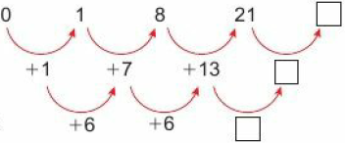
2.6 – Non Linear Sequences
Page 44
Copy and complete this diagram to workout the next term in the sequence 0, 1, 8, 21, ... sequence 1st differences 2nd differences
Work out the next term of each sequence.
6, 21, 46, 81, ... b. 2, 7, 16, 29, ... c. 0, 1, 3, 6, ...
Q10 hint - Begin with the second difference box, then the first difference box and finally the sequence box.
Q11 hint - Work out the first and second differences.

Slide 73
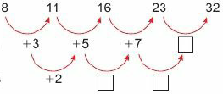
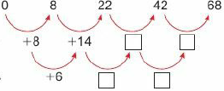
2.6 – Non Linear Sequences
Page 44
a. Copy and complete to work out first and second differences for the sequence u_{n} = n² +7. sequence 1st differences 2nd differences
Copy and complete for the sequence v_{n} = 3n² – n - 2
sequence 1st differences 2nd differences
Discussion Are the second differences increasing, decreasing or constant? What is the connection between the formula for the nth term and the second differences?

Slide 74
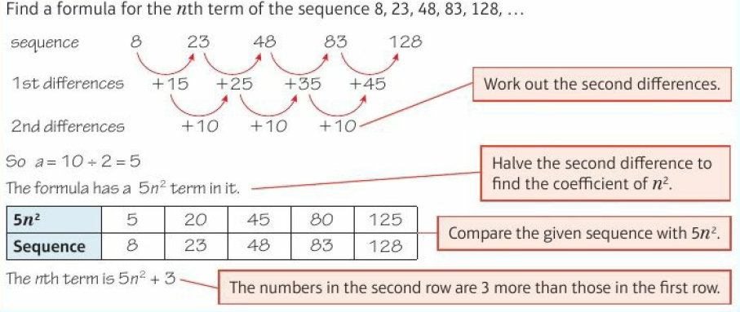
2.6 – Non Linear Sequences
Page 44
Key Point 16
The second differences of a quadratic sequence, u_{n} = an² + bn + c, are constant and equal to 2a.
Example 4

Slide 75
2.6 – Non Linear Sequences
Page 44
Reasoning Find a formula for the nth term of each of these quadratic sequences,
3, 9, 19, 33, 51, ...
-2, 7, 22, 43, 70, ...
4.5, 6, 8.5, 12, 16.5, ...
Reasoning Each number in Pascal’s triangle is found by adding the pair of numbers immediately above it.
Row 0 1
Row 1 1 1
Row 2 1 2 1
Row 3 1 3 3 1
Row 4 1 4 6 4 1
Work out the numbers in the next row.
Copy and complete the table for the sum of the numbers in each row.
Work out a formula for the sum of the numbers
Row, n | 0 | 1 | 2 | 3 | 4 | 5
Sum | 1 | 2

Slide 76
2.6 – Non Linear Sequences
Page 45
The sequence 2, 7, 14, 23, 34, ... has nth term in the form u_{n} = an² + bn + c
Find the second differences and show that a = 1.
Subtract the sequence n2 from the given sequence.
2 7 14 23 34
1 4 9 16 25
1 ◻ ◻ ◻ 9
Find the nth term of this linear sequence.
Write the nth term of 2, 7,14,23,34,... n² + ◻n - ◻

Slide 77
2.6 – Non Linear Sequences
Page 45
Key Point 17
The nth term of a quadratic sequence can be worked out in three steps.
Step 1 Work out the second differences.
Step 2 Halve the second difference to get the an² term.
Step 3 Subtract the sequence an². You may need to add a constant, or find the nth term of the remaining terms.
Find the nth term of each sequence.
4, 10, 18, 28, 40, ...
0, 1, 4, 9, 16, ...
5, 12, 23, 38, 57, ...
3, 11, 25, 45, 71,...
Q16 hint - Use the method in Q15.

Slide 78
2.6 – Non Linear Sequences
Page 45
Communication The nth term of a sequence is u_{n} = 10^{n}. Show that the product of u₅ and u₈ is u₁₃.
Q17 hint – x^{m} x x^{n} = x^{m+n}
18 – Exam-Style Questions
Write down the first four terms in the sequence with nth term u_{n} = 2^{n}. (2 marks)
State the term-to-term rule. (1 mark)
Use algebra to show that the product of any two terms in the sequence is also a term in the sequence. (2 marks)
Exam hint - The question refers to any two terms so no credit is given for just checking it out for particular numbers.

Slide 79
2.7 – More Expanding and Factorising
Page 46
Objectives |  | Why Learn This
Expand the product of two brackets. Use the difference of two squares. Factorise quadratics of the form x² + bx + c |  | Expanding two brackets is a skill needed for graphing and analysing quadratic functions.
Fluency
What is the square root of 64? What are the factor pairs of i. 12 ii. -6?
ActiveLearn - Homework, practice and support: Higher 2.7

Slide 80
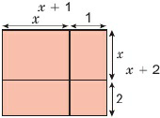
2.7 – More Expanding and Factorising
Page 46
Find a pair of numbers whose
product is 6 and sum is 5
product is 4 and sum is -5.
Simplify
(2x)²
(5y)²
a. Copy and complete this expression for the area of the whole rectangle, (x +◻)(◻ +1)
Write an expression for the sum of the areas of the smaller rectangles. Collect like terms and simplify.
Warm Up

Slide 81
2.7 – More Expanding and Factorising
Page 46
Key Point 16
To expand double brackets, multiply each term in one bracket by each term in the other bracket.
Example 5
Expand and simplify (x + 3)(x + 5)

Slide 82
2.7 – More Expanding and Factorising
Page 46
Expand and simplify
(x + 6)(x+ 10) b. (x + 6)(x - 3)
(x - 4)(x + 10) d. (x - 3)(x - 4)
Problem-solving Find the missing terms in these quadratic expressions.
(x + 2)(x + ◻) = x² + ◻x + 6
(x - ◻)(x + 8) = x² + 5x - ◻
Expand and simplify
(x + 2)² b. (x - 3)²
(x + 5)² d. (x - 4)²
Key Point 19
To square a single bracket, multiply it by itself, then expand and simplify.
(x + 1)2 = (x + 1)(x + 1) = x² + 2x + 1

Slide 83
2.7 – More Expanding and Factorising
Page 47
a. Copy and complete to evaluate 51² -49² without a calculator. (51 +49) (51 -49) - 2 x ◻ = ◻
Without using a calculator work out
101² - 992 ii. 1.03² - 0.97²
Expand and simplify
(x - 4) (x + 4) b. (x - 2)(x + 2)
Discussion Why can your answers be called 'difference of two squares?
Factorse
x² – 25 b. y² – 49
t² - 81
Q9a hint - Factorising is the inverse of expanding. x2 - 25 = (x )(x )

Slide 84
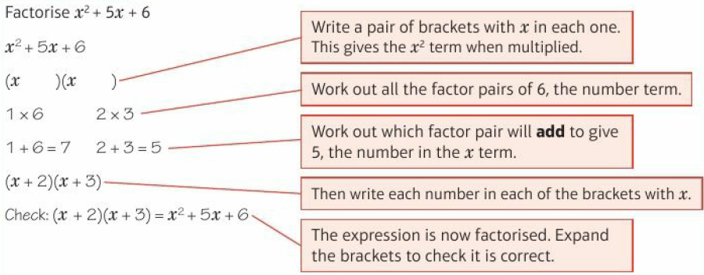
2.7 – More Expanding and Factorising
Page 47
Example 4
Example 4

Slide 85
2.7 – More Expanding and Factorising
Page 47
Factorise
x² + 8x + 7 b. x² + 7x +12
x² + 8x + 15 d. x² + 2x -2
x² – 2x - 3 f. x² - 6x +12
x² – 8x - 7 h. x² - 7x + 12
x² - 4x - 4 j. x² - 14x + 24
x² - 6x -16 l. x² + 2x + 1
Q10a hint - Find two numbers with product 7 and sum 8.
Q10d hint - For a product of- 3, one number must be positive and one number is negative.
Q10f hint - For a positive product but a negative sum both numbers must be negative.

Slide 86
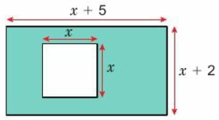
2.7 – More Expanding and Factorising
Page 47
Problem-solving A rectangular piece of paper has length (x + 5) cm and width (x + 2) cm. A square with sides of length, x cm is removed,
Write an expression for the area of the rectangle before the square is cut out. Expand the brackets.
Write an expression for the shaded area
Find x if the shaded area is 31 cm².

Slide 87
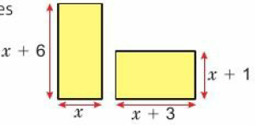
2.7 – More Expanding and Factorising
Page 47
Problem-solving / Reasoning The two rectangles shown have the same area. Find x.
Copy and complete these factorisations,
4x² - 9 = (2x)² - ◻² = (2x - ◻)(2x + ◻)
16y² - 1 = (◻y)² – ◻² = (◻y - ◻)(◻y + ◻)

Slide 88
2.7 – More Expanding and Factorising
Page 48
Factorise
9m² - 25 b. 25c² - 81
x² - 49y²
15 – Exam-Style Questions
Factorise x² +-11x + 30 (2 marks)
Expand (3u - 4v)² (3 marks)
Exam hint
In part a, check your factorisation by expanding the brackets.

Slide 89
2 – Problem Solving
Page 48
Objectives
Use smaller numbers to help you solve problems.
Example 8
A factory makes boxes of Christmas crackers. Each box contains 12 crackers.
The factory has 13 machines. Each day, each machine makes 1638 boxes of Christmas crackers. The same number of boxes is loaded on to each of 18 lorries,
How many crackers are on one lorry?
Write an expression for the number of crackers on a lorry when
each box contains c Christmas crackers
they are made in a factory that has m machines
each machine makes b boxes of Christmas crackers per day
the same number of boxes is loaded on to each of n lorries.

Slide 90
2 – Problem Solving
Page 48
Example 8
a. Using smaller numbers: Each box of Christmas crackers contains 2 crackers, 3 machines. Each machine makes 5 boxes of crackers. 4 lorries Total number of crackers on 1 lorry = 5 x 2 x 3 ÷ 4
Using numbers from the question:
Total number of crackers on 1 lorry
= 1638 x 12 x 13 ÷ 18 = 14196 b. Total number of crackers on a lorry
= $\frac{b x c x m}{n}$ = $\frac{bcm}{n}$
Replace the numbers in the question with smaller numbers.
Draw a picture
Use your picture to help you calculate how many crackers on one lorry. Then replace the smaller numbers with the corresponding numbers in the questions.
Replace the numbers in your calculation with the corresponding letters to write an expression.

Slide 91
2 – Problem Solving
Page 49
Luke is revising for a Spanish exam. Every day he reads 11 pages of his Spanish vocabulary book. There are 15 words on every page. After three weeks, he has only 35 words left,
How many words are in his Spanish vocabulary book?
Write an expression for the number of words in a vocabulary book when someone reads x pages per day, there are y words on every page, and after z weeks, the person has only m words left.
Q1a hint - Replace each number in the question with a smaller number and draw a picture too. There is no 'correct' picture. There is also no ‘correct’ smaller number.

Slide 92
2 – Problem Solving
Page 49
A farmer grows strawberries. The farmer employs 28 fruit pickers. Each day, each fruit picker picks 36 kg of strawberries. All the strawberries are packaged into plastic tubs. Each plastic tub contains 0.25 kg of strawberries. Then the same number of plastic tubs is put into each of 63 boxes,
How many plastic tubs are put into each box?
Write an expression for the number of plastic tubs in a box when p fruit pickers each pick q kg of strawberries, these are packaged into plastic tubs, each containing s kg of strawberries, and the same number of tubs is loaded into each of t boxes.
Q2a hint - Use a whole number instead of 0.25 kg.

Slide 93
2 – Problem Solving
Page 49
A vending machine has 24 different products. It stores 15 of each of these products. On average, people buy 35 products from the machine every day.
How many products remain in the vending machine at the end of 7 days?
Write an expression for the number of products remaining in the vending machine at the end of n days when a vending machine has x different products, it stores y of each of these products, and on average, people buy m products from the machine every day.

Slide 94
2 – Problem Solving
Page 49
22 office workers send an email to each other,
How many emails are sent altogether?
Write an expression for the number of emails sent by x workers.
Q4 hint - Sometimes it is helpful to try a series of smaller numbers to look for a pattern.

Slide 95
2 – Problem Solving
Page 49
a. Write down the 137th odd number.
Write an expression for the nth odd number.
How many times do two or more odd digits appear in a number when counting from 0 to 999?
Reflect Did using smaller numbers help you? Is this a strategy you would use again to solve problems? What other strategy or strategies helped you to solve these problems?
Q5 hint - Write down the 1st, 2nd,3rd odd numbers. How do you find the 137th odd number?
Q6 hint - How many times do two or more odd digits appear in numbers
0-9 10-19 20-29 30-39... 100-109 110-119 120-129 130-139...

Slide 96
2 – Check up
Page 50
2. Check up
Log how you did on your Student Progression Chart
Simplifying, expanding and factorising
Simplify
4p x 5p³ b. 15x⁴ + 3x²
(b²)⁻³
Expand and simplify 3(2p + q) - 2(3p - q)
Factorise
2xy - 6y b. 3ab - 6a²
Expand and simplify
(x + 4)(x - 6) b. (x + 5)²

Slide 97
2 – Problem Solving
Page 50
Simplify
2x⁻² b. 4x⁰
(9c²)^{½} d. $\frac{\text{16}\text{p}\text{−}\text{2}}{\text{4}\text{p}\text{3}}$
Expand and simplify (2s - r)(s + 3r)
Factorise
x² – 81
x² – 9x + 14

Slide 98
2 – Problem Solving
Page 50
Equations and formulae
Write whether each of these is an expression, an equation, an identity or a formula,
v = u + at b.
a² - b² = (a - b)(a + b)
mv d. 4a = 5
Solve 4x - 3 = 2x + 6
Solve 2(3x + 1) = 5(x - 3)
Use the formula z =f² - 2fg to work out the value of z when f = 10 and g = 3.
Communication Show that the equation x³ + 4x = 6 has a solution between 1.1 and 1.2

Slide 99
2 – Problem Solving
Page 50
Equations and formulae
An electrician charges a £25 call-out fee, plus £36 per hour. Write a formula for his total charge £C for n hours' of work.
a. Make y the subject of the formula 2x + 3y = 4
Make b the subject of the formula S = 6ab + 4a²
Solve $\frac{x}{3}$ - $\frac{x}{4}$ = $\frac{5}{6}$

Slide 100
2 – Problem Solving
Page 50
Sequences
Write down the next two terms in the Fibonacci sequence 3,4,7,11, ....
a. Find the nth term of the arithmetic sequence 2, 11, 20, 29, ...
Show that 167 cannot be a term in this sequence.
Find the first number in the sequence that is greater than 167.
Find the nth term of the sequence 10, 19, 34, 55, ...
ActiveLearn - Homework, practice and support: Higher 2 Check Up

Slide 101
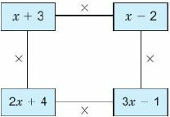
2 – Problem Solving
Page 51
Sequences
How sure are you of your answers? Were you mostly Just guessing ☹ Feeling doubtful 😐 Confident ☺ What next? Use your results to decide whether to strengthen or extend your learning.
* Challenge
a. Multiply together the four pairs of connected terms and expand your answers.
Add together your answers and simplify the result. Would the result have been the same if you had expanded in a different order?
Factorise your simplified expression.
Reflect

Slide 102
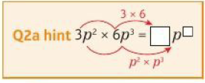
2 – Strengthen
Page 51
2. Strengthen
Simplifying, expanding and factorising
Simplify
t³ x t² b. t⁴ x ^{t3}
t x t³ d. t⁻² x t⁴
t⁻⁶ x ^{t-1} f. t^{½} x t^{3/2}
Simplify
3p² x 6p3 b. 8z x 9z⁴
7b³ x 2b⁵ d. 2r⁵ x 4r⁻²
2x^{2/3} x 3x^{4/3} f. 5s⁻² x 2s⁻⁴

Slide 103
2 – Strengthen
Page 51
Copy and complete
t⁶ + t² = t◻ b. t⁵ - t² = t◻
t³ ÷ t³ = t◻ = ◻
Simplify
20p⁶ ÷ 4p²
$\frac{12a7}{4a2}$
$\frac{9y−1}{3y2}$ d. $\frac{6p1/2}{3p−3/2}$
Q3a hint - What do you multiply t² by to get t⁶?
Q4a hint –
20 ÷ 4 p⁶ ÷ p²
= ◻ p◻
= ◻p◻
Q4a hint – ◻y⁻¹⁻² = ◻y◻

Slide 104
2 – Strengthen
Page 51
Copy and complete
(x²)² = ◻◻ x ◻◻ x ◻◻
(x²)³ = ◻◻ x ◻◻ x ◻◻ x ◻◻
(x²)² = ◻◻ x ◻◻ x ◻◻ x ◻◻ x ◻◻
What do you notice about powers and brackets? What is the rule?
Simplify
(a⁴)^{3/2} b. (r²)⁻¹ c. (2g^{1/3})³
Q6a hint – Use the rule you noticed in Q5d.
ActiveLearn - Homework, practice and support: Higher 2 Strengthen

Slide 105
2 – Strengthen
Page 51
a. Expand 3(2x + y)
Expand 2(3x - 4y)
Expand and simplify 3(2x + y) + 2(3x - 4y)
Expand and simplify
2(4c + 5d) + 3(c - 3d)
6(3m + n) - 4(m - n)
Q7a hint – Use a multiplication grid x | 2x | y_
3 | |
Q8 hint – Use grids to help you.

Slide 106
2 – Strengthen
Page 52
Copy and complete the factorisations.
3ab² - 2ab = ab(◻ ... ◻)
8xy + 6x = 2◻(◻ ... ◻)
3st² - 6st = ◻(◻... ◻)
14ab² +21b = ◻(◻ … ◻)
Q9a hint – Find the common factors.
3ab² = 3 x a x b x b
-2ab = -2 x a x b
3ab² = ab x 3b -2ab = ab x -2
Q9b hint – Start with 8xy + 6x = 2 x 4 x ◻ x ◻
6x = 2 x 3 x ◻
Now follow the method from part a

Slide 107
2 – Strengthen
Page 52
a. Copy and complete the multiplication grid.
Use your answer to part a to expand (x + 4)(x + 5) = x² + 5x + ◻ + 20 = x² + ◻x + 20
a. Use this grid to expand (x - 6)²
Use a grid to expand (x - 4)(x + 4)
x | 3x | +5
x | x²
+4
x | x | -6
x | X²
-6

Slide 108
2 – Strengthen
Page 52
Use the grids to expand and simplify
(x + 8)(3x + 2) b. (2x +1)(5x + 3) c. 3x – 7)(x + 4)
Factorise
x²+ 13x + 12
x² + 7x + 12
x | 3x | +2
X
+8
x | 2x | +1
5x
+3
x | 3x | -7
x
+4

Slide 109
2 – Strengthen
Page 52
Match the expressions to their factorisations.
a. There are three pairs of positive integers whose product is 12. One pair is 1 and 12. Write down the other two pairs,
Which pair of numbers in part a add up to 8?
Use your answer to part b to factorise x² + 8x +12 = (x + ◻)(x + ◻)
(x - 3)²
X² + 6x +5
(x + 1)(x +5)
x² - 9
x² – 6x + 9
(x + 3)(x + 2)
x² + 5x + 6
x² – x -6
(x + 2)(x – 3)
(x - 3)(x + 3)
Q13 hint – Expand the brackets to check
Q14 hint –

Slide 110
2 – Strengthen
Page 52
a. There are four pairs of integers whose product is -10. One pair is -2 and +5. Write down the other three pairs,
Use your answers to part a to factorise
x² - 9x - 10 ii. x² + 9x- 10
x² + 3x - 10 iv. x² - 3x – 10
a. There are four pairs of integers that multiply to 24 and add up to a negative number. One pair is -8 and -3. Write down the other three pairs.
Use your answer to part a to write down the factorisation of
x² - 25x + 24 ii. x² - 14x + 24
x² - 10x + 24 iv. x²- 11x + 24

Slide 111
2 – Strengthen
Page 53
Equations and formulae
Write whether each of these is an identity, a formula, an expression or an equation,
2x b. x + 2x = 3x
y = 2x d. 2x = 1
When U = 5 and V = 3, workout
V² b. 4V²
4V² + U
Q1 hint - When there is no = sign it is ...
When the two sides are always equal it is …
When you can solve it to find the value of the letter it is ...

Slide 112
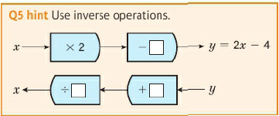
2 – Strengthen
Page 53
Use the formula m = 2x² + g to work out m when x = 3 and g = 5.
Use the formula t = r² - 3rs to work out t when r = 5 and s = 2.
Make x the subject of the formula y = 2x - 4
Q3 hint – m = 2x² + g = 2 x ◻² + ◻

Slide 113
2 – Strengthen
Page 53
Make Q the subject of the formula P = $\frac{Q}{a}$ + b
a. Make b the subject of c = $\frac{3b}{4}$
Make s the subject of v² = u² + 2as
Solve the equation 5x -1 = 3x + 7
Q6 hint – Use function machines to help you.
Q8 hint – You need to get only unknowns (x) on one side of the equals, and only numbers on the other side.

Slide 114
2 – Strengthen
Page 53
a. Expand the brackets.
7(2x - 4) ii. 2(3x + 5)
Solve the equation 7(2x - 4) = 2(3x + 5)
a. Expand and simplify 7(2x + 1) - 3(4x + 3)
Solve 7(2x + 1) - 3(4x + 3) = 5
Simplify:
$\frac{7x}{7}$ b. $\frac{4x}{2}$ c. $\frac{20x}{5}$
Q9b hint – Rewrite the equation using your expressions from part a.

Slide 115
2 – Strengthen
Page 53
Solve these equations. Start by multiplying both sides of the equation by 5.
$\frac{x}{5}$ = 4 b. $\frac{3x}{5}$ = 2
Solve these equations
$\frac{x}{6}$ = 3 b. $\frac{4x}{7}$ = 1
How do you decide what to multiply by?
Solve these equations
$\frac{x}{4}$ - $\frac{x}{5}$ = 3 b. $\frac{x + 1}{7}$ = $\frac{x}{2}$
Q14a hint – Multiply by 4 x 5 = 20

Slide 116
2 – Strengthen
Page 54
Write down the next two terms in each of these Fibonacci sequences.
1, 1, 2, 3, 5, 8, ...
5, 7, 12, 19, 31, ...
2, 4, 6, 10, 16, 26, ...
Work out the first three terms of the sequence with nth term
2n + 3 b. 50 - 2n
n² + 1 d. 10n²
Q1 hint – The rule is 'add two terms to get the next‘.
Q2 hint – Substitute n = 1, n = 2, n = 3 into each formula.

Slide 117
2 – Strengthen
Page 54
The first five terms of an arithmetic sequence are 3, 6, 9, 12, 15.
These are multiples of ◻.
What is the 12th term?
Copy and complete this statement.
The general term is ◻n
Workout a formula for the nth term of each of these arithmetic sequences,
10, 20, 30, 40, 50, ...
7, 14, 21, 28, 35, ...
Q3a hint – Which times tables are these numbers in?
Q4 hint –Use the method from Q3.

Slide 118
2 – Strengthen
Page 54
Look at the sequence in the table.
What number do you add to each number in the top row of the table to get the number in the bottom row?
Copy and complete this statement. The nth term is n + ◻
Write down a formula for the nth term of each of these arithmetic sequences,
3, 4, 5, 6, 7, ...
13, 14, 15, 16, 17, ...
-3, -2, -1, 0, 1, ...
Term Number | 1 | 2 | 3 | 4 | 5 | 6
Term | 7 | 8 | 9 | 10 | 11 | 12
Q5b hint – Check your answer by substituting n = 1, n = 2, n = 3.

Slide 119
2 – Strengthen
Page 54
These two sequences have the same common difference. Sequence A: 4, 8, 12, 16, 20, ... Sequence B: 7, 11, 15, 19, 23, ...
Work out the nth term of sequence A.
What do you add to each term in sequence A to get the terms in sequence B?
Write the nth term of sequence B.
Q7a hint – The numbers in sequence A are multiples of ◻ so the nth term is ◻ n.
Q7c hint – Use your answers from parts a and b.

Slide 120
2 – Strengthen
Page 55
a. Write down the next two terms in each of these arithmetic sequences.
6,12, 18, 24, ...
1, 3, 5, 7, ...
4, 7, 10, 13, ...
25, 20, 15, 10, ...
Find the nth term of each sequence in part a.
a. Write down the first five terms of the sequence with nth term u_{n} = 10 + 4n.
Explain why 351 cannot be a term of this sequence,
Which term of the sequence is 102?
Q8b hint – Use the method from Q7
Q9b hint – Can this sequence have odd numbers in it?
Q9c hint – Solve 10 + 4n = 102

Slide 121
2 – Strengthen
Page 55
The nth term of an arithmetic sequence is 5n + 7.
Which term of the sequence is 107?
Find the first term in the sequence which is bigger than 108.
Find the first term in the sequence which is bigger than 150.
Q10a hint – What equation do you need to solve.
Q10c hint – Solve 5n + 7 = 150. Use the net integer value of n.

Slide 122
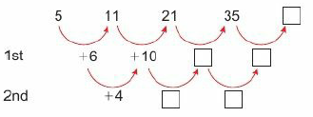
2 – Strengthen
Page 55
a. Copy and complete the first and second differences for this sequence and work out the next term.
Find a formula for the nth term.
Find a formula for the nth term of each of these quadratic sequences,
9, 21, 41, 69, ...
-9, -6, -1, 6, ...
Q11b hint – The formula is an² + b where a is half of the second difference. For the first term n = 1 and the term is 5. Substitute n=1 and your value of a into an² + b = 5 to find b.
Q12 hint – Use the method from Q11.

Slide 123
2 – Extend
Page 55
2. Extend
Reasoning a. Write down the next three terms in each sequence.
u₁ = 5, ...u_{n+1} = u_{n} +1
u₁ = 40, ... u_{n+1} = $\frac{1}{2}$u_{n}
u₁ = 7, ... u_{n+1} = u_{n} - 4
u₁ = 1, ... u_{n+1} = -3u_{n}
Which of these sequences are arithmetic and which are geometric?
Q1a i hint – U₂ = U₁ + 1

Slide 124
2 – Extend
Page 55
Reasoning a. The 1st term of an arithmetic sequence is 0.341 and the 2nd term is 0.407 Work out the 3rd term.
The 1st term of an arithmetic sequence is 9 and the 3rd term is 14. Work out the 2nd term.
The 1st term of an arithmetic sequence is 4 and the 5th term is 16. Work out the 4th term.
The 1st term of an arithmetic sequence is 5.8 and the 2nd term is 5.9. Work out the 100th term.

Slide 125
2 – Extend
Page 56
Modelling A clothing store monitors sales in-store and online. Sales for the last few years are shown in the table.
Assuming both types of sales form a geometric sequence
work out the sales of each type for the next two years
work out the year when online sales are predicted to exceed in-store sales.
Year | 2010 | 2011 | 2012 | 2013 | 2014 | 2015
In-Store | 31250 | 25000 | 20000 | 16000
On-line | 640 | 960 | 1440 | 2160

Slide 126
2 – Extend
Page 56
Finance The formula gives the monthly repayments, £M, needed to pay off a mortgage over n years when the amount borrowed is £P and the interest rate is r%.
Pr(1 + $\frac{1}{100}$r)^{n}
1200 [(1 + $\frac{1}{100}$r)^{n} -1]
Calculate the monthly repayments when the amount borrowed is £250000 over 25 years and the interest rate is 5%.
Problem-solving Raj attempts a multiple choice test with 20 questions. He scores 5 marks for a correct answer but loses 2 marks if it is incorrect. Raj attempts all 20 questions and gets a total score of 51. How many answers did he get right?
M = _______________
Q5 strategy hint - Let a: be the number of correct answers.

Slide 127
2 – Extend
Page 56
Real The deposit, D, needed when booking a skiing holiday is in two parts:
a non-returnable booking fee, B
one-tenth of the total cost of the holiday, which is worked out by multiplying the price per person, P, by the number of people, N, in the party. D = B + $\frac{NP}{10}$
Find the deposit needed to book a holiday for four people when the cost per person is £2000 and the booking fee is £150.
Make P the subject of the formula.
What is the price per person when D = £500, B = £150 and N = 5?

Slide 128
2 – Extend
Page 56
Change the subject to the letter given in the brackets.
v² = u² + 2as [a]
V = $\frac{1}{3}$πr²h [h]
S = $\frac{a(rn −1)}{r −1}$ [a]
a²x – b²y = c [y]
Simplify
$\frac{4c2d}{2c−2d−3}$
4x^{½}y⁻² x 3x^{3/2}y³
(2m^{¼}n^{¾})
$\sqrt[3]{8p_3q12}$

Slide 129
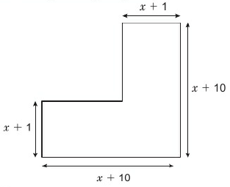
2 – Extend
Page 57
9 – Exam-Style Questions
Work out a simplified expression for the area of this shape
All the angles are right angles.
(4 marks)

Slide 130
2 – Extend
Page 57
10 – Exam-Style Questions
Expand and simplify (p + 9)(p - 4) (2 marks)
Solve $\frac{5w −8}{3}$ = 4w + 2 (3 marks)
Factorise x² – 9 (1 mark)
Simplify (9x⁸y³)^{½} (2 marks)
June 2012, Q14, 1MA0/1H
Exam Hint
Check your solution to part b by substituting back into the equation.

Slide 131
2 – Extend
Page 57
11 – Exam-Style Questions
You can change temperatures from °F to °C by using the formula C = $\frac{5(F −32)}{9}$
F is the temperature in °F.
C is the temperature in °C.
The minimum temperature in an elderly person's home should be 20°C. Mrs Smith is an elderly person.
The temperature in Mrs Smith’s home is 77 °F.
a Decide whether or not the temperature in Mrs Smith’s home is lower than the minimum temperature should be. (3 marks)
Make F the subject of the formula C = $\frac{5(F −32)}{9}$ (3 marks)
June 2014, Q12, 1MA0/1H
Exam Hint
You need to show calculations to support your decision in part a.

Slide 132
2 – Extend
Page 57
Communication
Explain why 2n +1 is an odd number for any integer n.
Show that the product of two odd numbers is always odd.
Factorise completely
x² - 12x + 32
x² - 12x + 36
x² – x -2 d. $\frac{x2}{25}$ - $\frac{y2}{49}$
Q12b hint - How could you write the product of two different odd numbers, algebraically?

Slide 133
2 – Extend
Page 57
Solve
3(2x -1) - 4(3x -2) = 10
$\frac{2}{3}$(x + 4) = $\frac{4}{5}$(x - 1)
$\frac{x}{6} −\frac{3x}{8}$ = 1 d. $\frac{5x+7}{14} −\frac{1 −2x}{21}$
Communication Show that the difference between consecutive square numbers is always an odd number.
Find the nth term of each sequence,
1, -5, -15, -29, -47, ...
0, -1, -4, -9, -16, ...
Q16 hint - The second differences are negative so -◻n2 + bn + c

Slide 134
2 – Knowledge Check
Page 58
2. Knowledge Check
x^{m} x x^{n} = x^{m+n} x^{m} ÷ x^{n} = x^{m-n} (x^{m})^{n} = x^{mn} x⁰ = 1 x-^{m} = $\frac{1}{\text{x}\text{m}}$ x^{1/n} = $\sqrt[n]{x}$ When the two sides of a relation such as 2(x + 5) = 2x + 10 are equal for all values of x it is called an identity and we write 2(x + 5) = 2x + 10 using the '=’ symbol An equation, such as 2x = 6, is only true for certain values of x (in this case x = 3) To expand a bracket, multiply each term inside the brackets by the term outside the brackets. x(y + z) = xy + xz Unless a question asks for a decimal answer, give non-integer solutions to an equation as exact fractions To solve an equation involving fractions, multiply each term on both sides by the LCM of the denominator.
Mastery Lesson 2.1
Mastery Lesson 2.2
Mastery Lesson 2.2
Mastery Lesson 2.2
Mastery Lesson 2.3
Mastery Lesson 2.3

Slide 135
2 – Knowledge Check
Page 58
2. Knowledge Check
An expression contains letter and number terms but no equals sign, e.g. 2ab, 2ab + 3a²b, 2ab - 7. An equation has an equals sign, terms in one letter and numbers, e.g. 2x - 4 = 9x + 1 You can solve it to find the value of the letter. An identity has an equals sign and is true for all values of the letters, e.g. $\frac{4x}{2}$ = 2x, x(x + y) = x² + xy. A formula has an equals sign and letters to represent different quantities, e.g. A = πr² The letters are variables as their values can vary. The subject of a formula is the letter on its own, on one side of the equals sign
Mastery Lesson 2.4
Mastery Lesson 2.4
Mastery Lesson 2.4
Mastery Lesson 2.4
Mastery Lesson 2.4

Slide 136
2 – Knowledge Check
Page 58
2. Knowledge Check
In an arithmetic sequence the terms increase (or decrease) by a fixed number called the common difference. When an arithmetic sequence with common difference d is input into this function machine, the output sequence has common difference p x d. In a Fibonacci-like sequence the next number is found by adding the previous two numbers together. In a geometric sequence the terms increase (or decrease) by a constant multiplier. The nth term is ar^{n} A quadratic sequence has n² and no higher power of n in its nth term. The second differences of a quadratic sequence, u_{n} = an² + bn + c are constant and equal to 2a.
Mastery Lesson 2.5
Mastery Lesson 2.5
Mastery Lesson 2.6
Mastery Lesson 2.6
Mastery Lesson 2.6
Mastery Lesson 2.6

Slide 137
2 – Knowledge Check
Page 59
2. Knowledge Check
The nth term of a quadratic sequence can be worked out in three steps. Step 1 Work out the second differences. Step 2 Halve the second difference to get the an² term. Step 3 Subtract the sequence an². You may need to add a constant, or find the nth term of the remaining terms To expand double brackets, multiply each term in one bracket by each term i n the other bracket To square a single bracket, multiply it by itself, then expand and simplify, e.g. (x +l)² = (x + l)(x +1) = x² + 2x + 1 A quadratic expression has a squared term (and no higher power), e.g. x² + 8x + 10
Mastery Lesson 2.6
Mastery Lesson 2.7
Mastery Lesson 2.7
Mastery Lesson 2.7

Slide 138
2 – Knowledge Check
Page 59
2. Knowledge Check
Choose A B or C to complete each statement about algebra. In this unit I did... A well B OK C not very well I think algebra is... A easy B OK C hard When I think about doing a algebra, I feel A confident B OK C unsure Did you answer mostly As and Bs? Are you surprised by how you feel about algebra? Why? Did you answer mostly Cs? Find the three questions in this unit that you found the hardest. Ask someone to explain them to you. Then complete the statements above again.

Slide 139
2 – Unit Test
Page 59
2 Unit Test | Log how you did oil your Student Progression
Workout the next two terms of the Fibonacci sequence, 4, 7, 11, 18, 29 ...
Write whether each of these is an expression, a formula, an equation or an identity.
4(3x + 1) = 5x – 6 (1 mark)
4(3x + 1) (1 mark)
4(3x + 1) = 12x + 4 (1 mark)
y = 4(3x +1) (1 mark)
Solve
4(5x - 2) = 32 (3 marks)
7x + 3 = 2x - 12 (3 marks)

Slide 140
2 – Unit Test
Page 59
Simplify
7q² x 9q³ (2 marks)
$\frac{25y4}{5y}$ (2 marks)
(c⁴)² (1 mark)
Expand
3*(4* + y) (2 marks)
(x + 4)(x - 3) (2 marks)
(x - 7)² (2 marks)
Find the first three terms of the sequence with nth term u_{n} = 81 x ($\frac{1}{3})$^{n} (3 marks)
ActiveLearn - Homework, practice and support: Higher Unit Test

Slide 141
2 – Unit Test
Page 59
a. Find the nth term of the arithmetic sequence 4, 10, 16, 22, 28,... (2 marks)
Show that 231 is not in the sequence. (1 mark)
Find the smallest number in this sequence which is greater than 234. (3 marks)
Reasoning The value of a car goes down by 10% a year. A car costs £40000
How much is it worth after
1 year ii. 2 years? (2 marks)
After how many years is it worth less than half of its original price? (2 marks)
Does the answer to part b increase, decrease or stay the same when
the cost of the new car is changed to £12000 (1 mark)
the rate of decrease is changed to 20%? (1 mark)

Slide 142
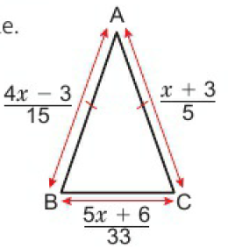
2 – Unit Test
Page 60
Make x the subject of the formula y = 2x + 5 (2 marks)
Reasoning Find the nth term of the sequence 2, 11, 26, 47, ... (6 marks)
Reasoning The diagram shows an isosceles triangle. All lengths are in centimetres,
Write down an equation for x. (1 marks)
Solve the equation, (2 marks)
Work out the length of BC. (2 marks)

Slide 143
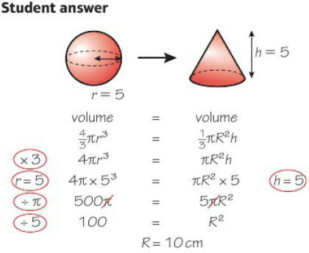
2 – Unit Test
Page 60
Sample student answer
How does drawing the 3D shapes help?
Where can you get help with the formulae in an exam?
How does the student's layout of the answer help ensure no mistakes are made?
Why has the student used a capital R for the radius of the cone?
Exam-Style Questions
A sphere of metal, radius 5 cm, is melted down and made into a cone of the same volume.
The perpendicular height of the cone needs to be 5cm.
What will the base radius of the cone be? (3 marks)

